Slide 1

A Look at MPG Over the Years
Ricardo Cortez-plq0921
Sta-6233

Slide 2
Motivation
Notes:
New Truck – better MPG than my Dad’s old truck, even better than my 2012 sports car
Got interested in seeing the trends and what policies affected car manufacturers and how MPG have improved over the past few years.

Slide 3
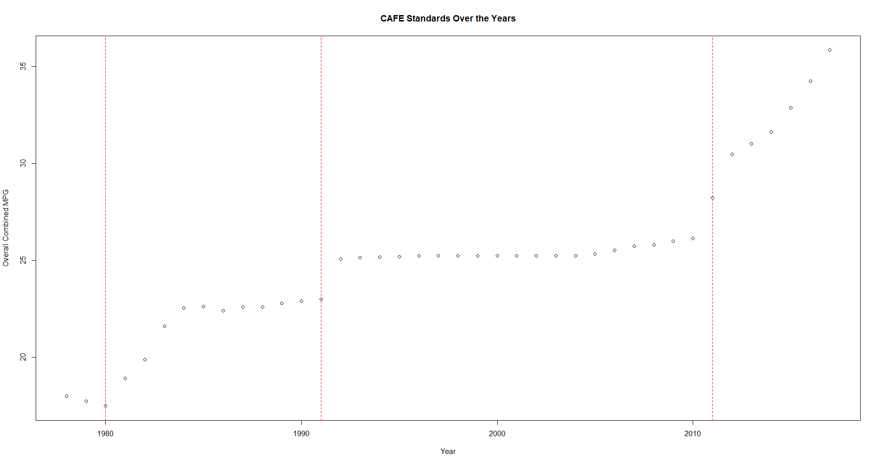

Legal Precedent
CAFÉ – Standards
Calculation – Harmonic Mean
Notes:
2007 EISA Engergy Independence and Security Act passed set national fuel standard of 35 mpg by 2020
Could spend the whole presentation and then some talking about all the standards, but 2007 stuck out for several reasons that I’ll point out later.

Slide 4
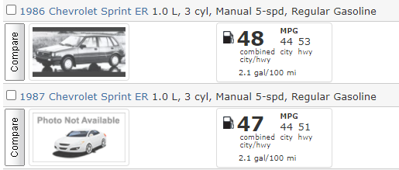
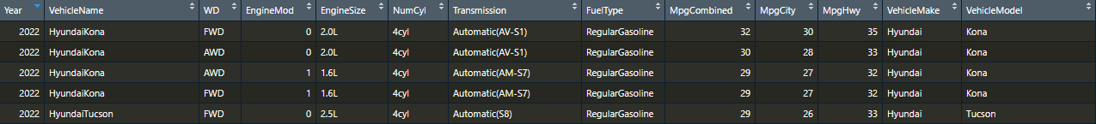
The Data
https://www.fueleconomy.gov/
Gas only, scope was getting too big with electric vehicles
Notes:
Cleaning the data took a while
Did not come in a clean table of any sort

Slide 5
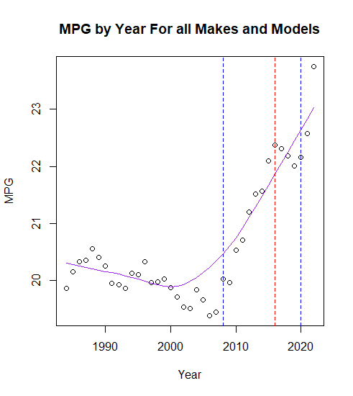
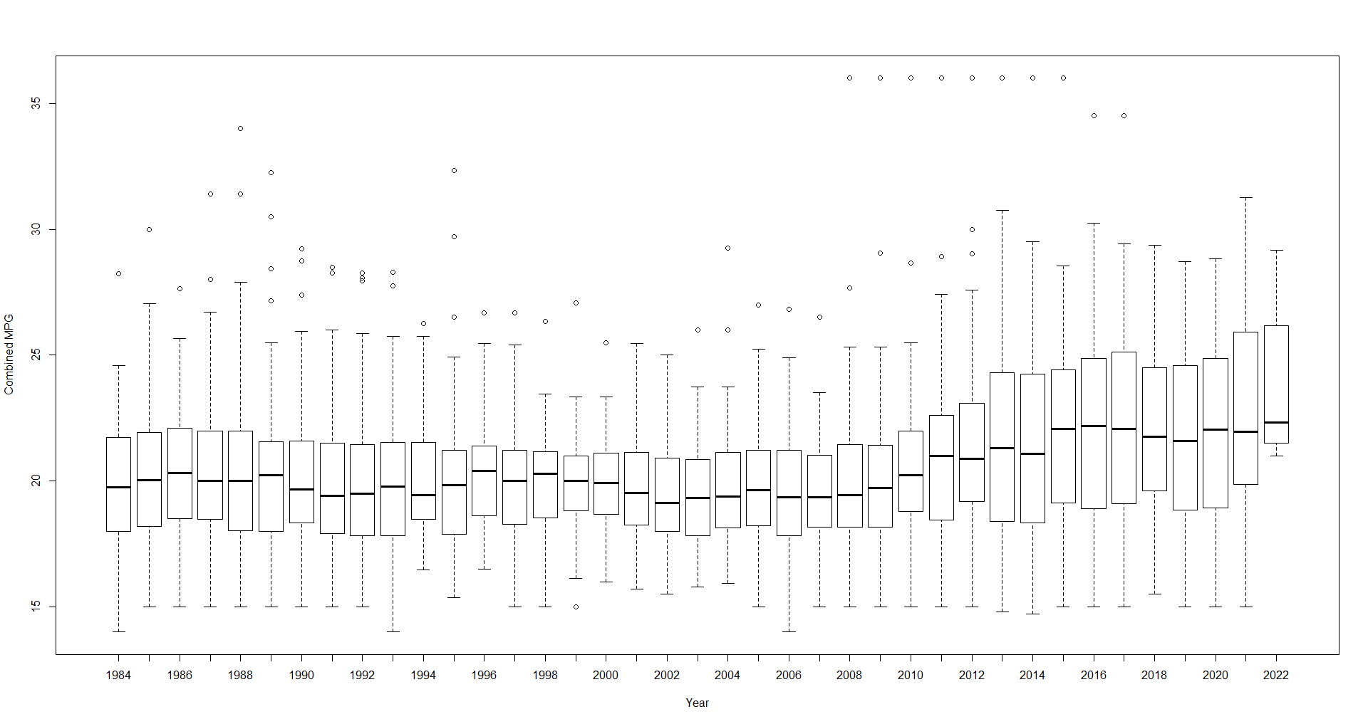
Averages

Slide 6
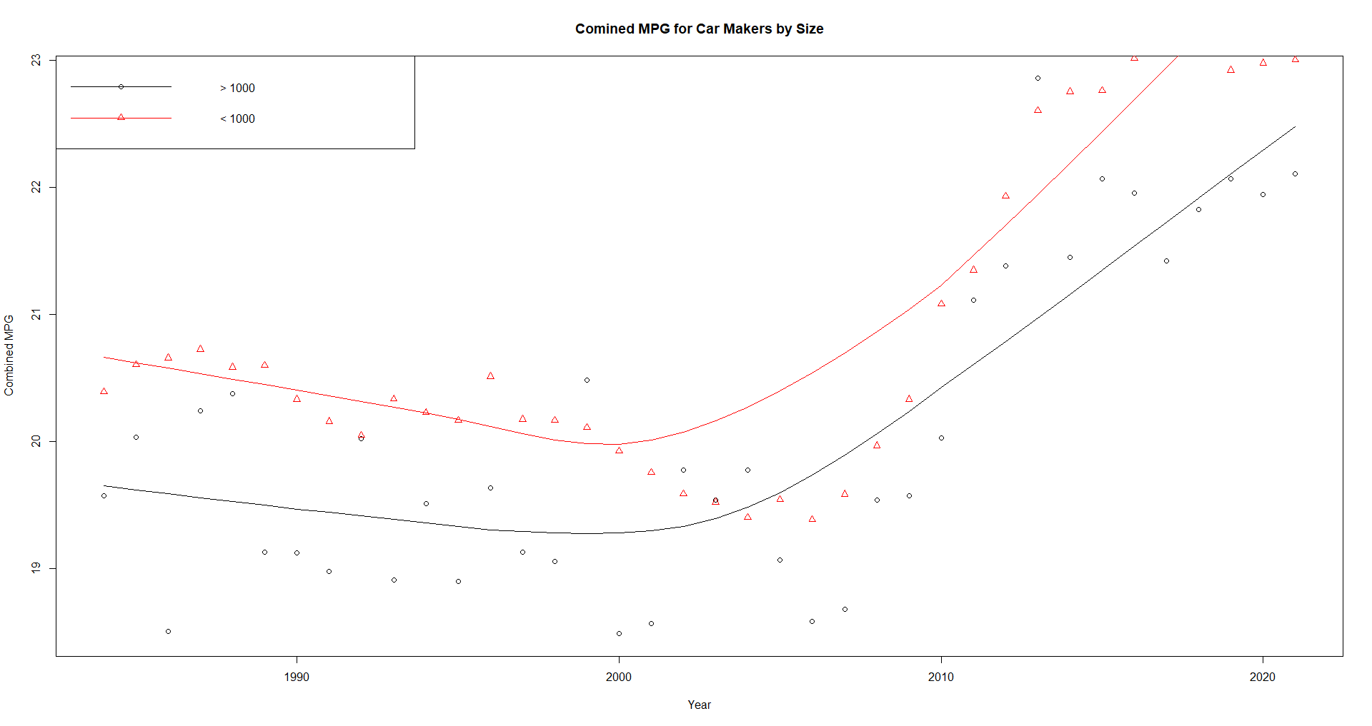
Maker Size Vs MPG
>1000 ~ 1600 obserations
<1000 ~ 33088 observations

Slide 7
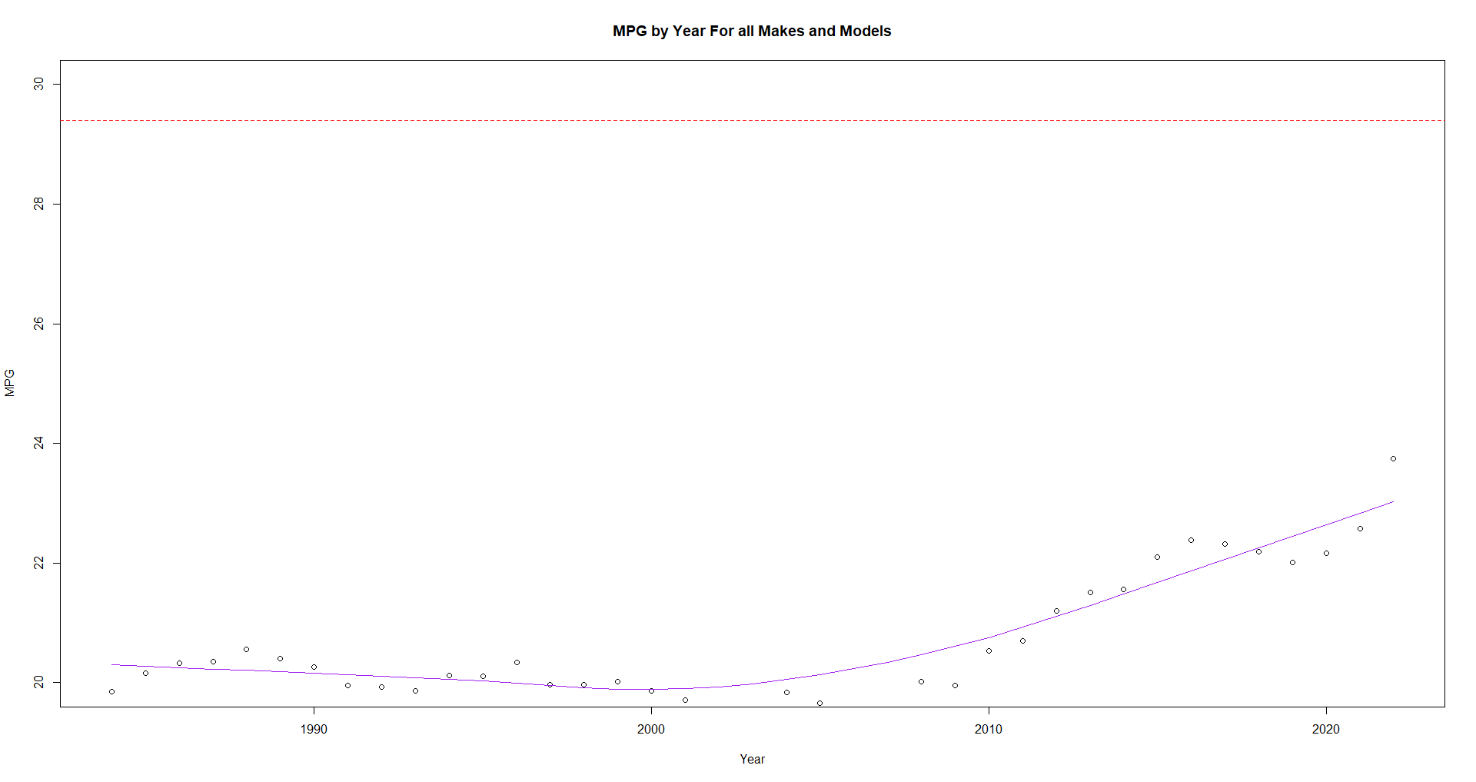
Room for Growth
Overall Positive Growth
Controversy around CAFÉ standards

Slide 8
Enhancements
Look into Number of Cars Sold
Break vehicles into categories for cars/trucks/suv’s/etc.
Expand into analysis for Electric/Hybrid Vehicles

Slide 9
Code
https://github.com/Rmcortez12/spring-2021-Advanced-R

